Slide 1
Feasibility of Beam Reinforcement Optimization for Practical Application
Advisor : Prof. K.C.Chang
Presenters : You-Ran Nai
Notes:
Try 講清楚脈絡

Slide 2
Outline
Part 2
Part 4
Methodology
Seismic Verification
Part 1
Part 3
Objective
Condition

Slide 3
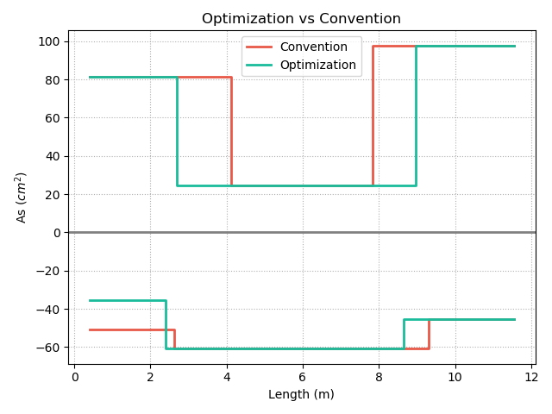
Top
12-#10
10-#10
REDUCE REBAR
3-#10
7-#8
9-#8
12-#8
Fix
Length
Real
Demand
Bottom
Notes:
用最有感覺的圖

Slide 4
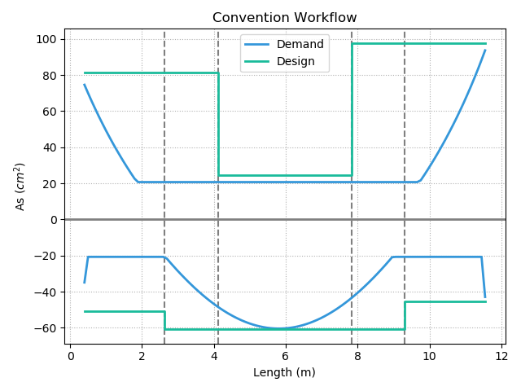
12-#10
10-#10
Today’s Solution
Fixed Cut-Off
3-#10
10-#8
9-#8
12-#8
Notes:
LowSeismic4Floor12M 0

Slide 5
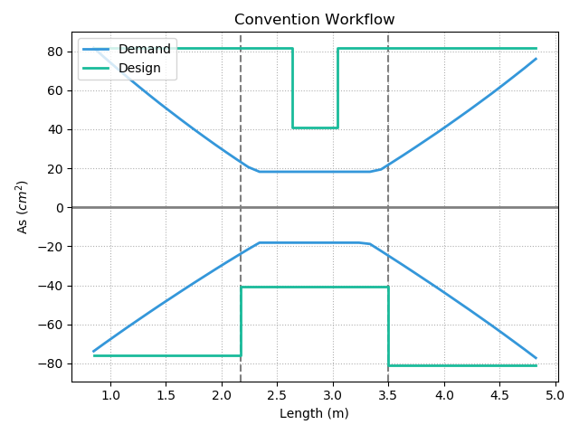
Today’s Solution
Notes:
欣銓 1140

Slide 6
Outline
Part 2
Part 4
Methodology
- Flexural
- Shear
Seismic Verification
Part 1
Part 3
Objective
Condition

Slide 7
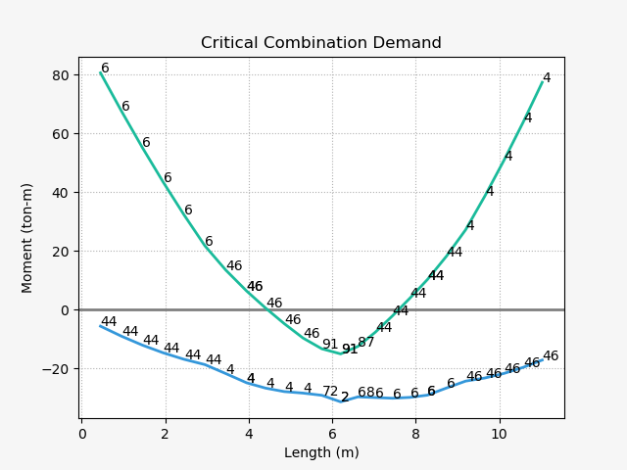
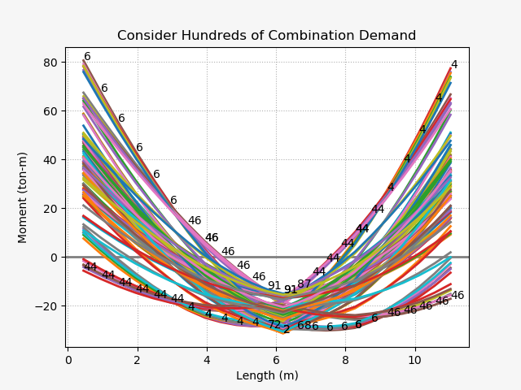
Design Moment - Mu
(1) U=1.4D
(2) U=1.2D + 1.6L
(3) U=1.2D + (1.0L or 0.5L)
(4) U=1.2D + 1.6W + (1.0L or 0.5L)
(5) U=1.2D + 1.0E + (1.0L or 0.5L)
(6) U=0.9D + 1.6W
(7) U=0.9D + 1.0E

Slide 8
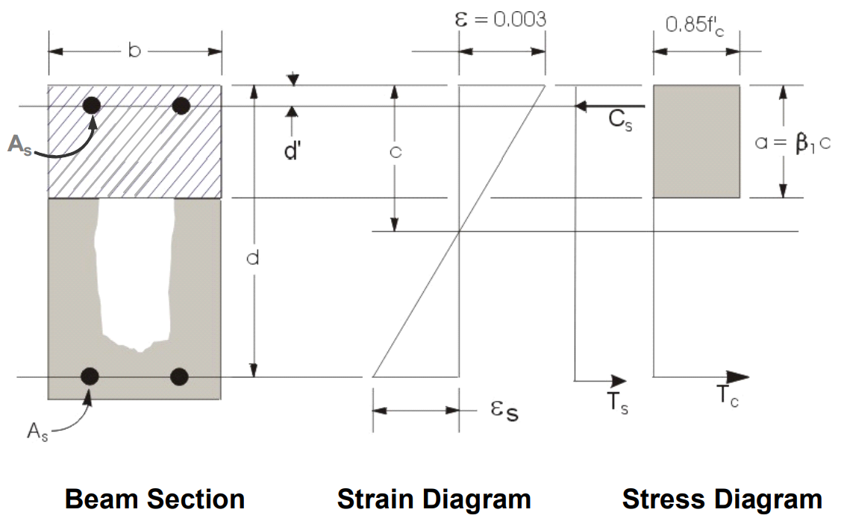
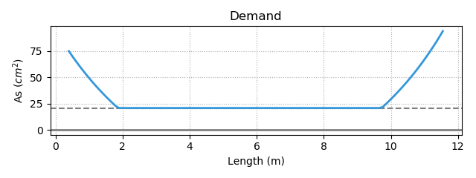
Flexural Reinforcement
- Demand As
Minimum Reinforcement
Notes:
LowSeismic 4Floor 12M 0

Slide 9
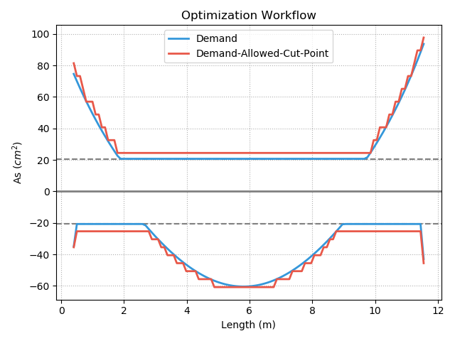
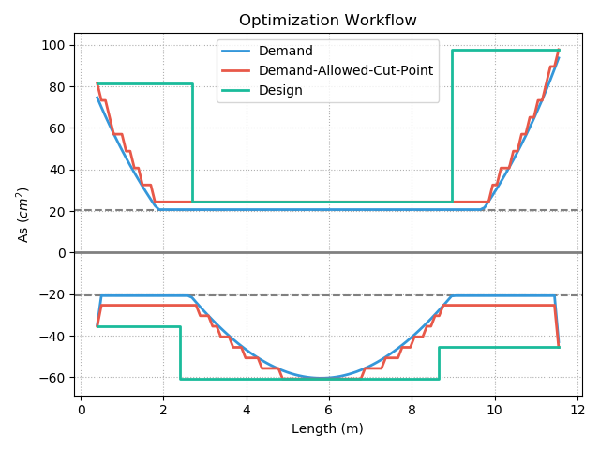
Procedure A – Effect

Slide 10
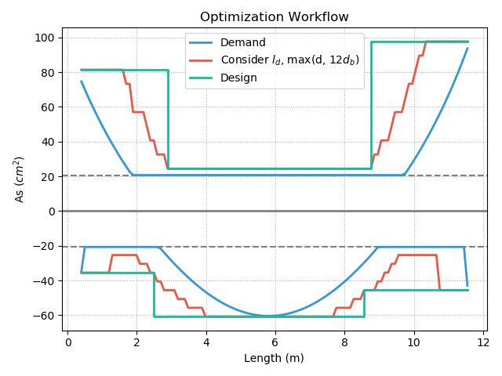
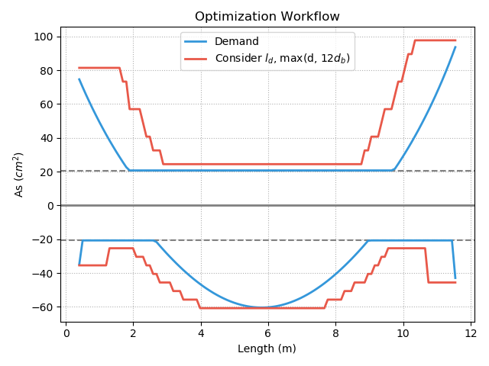
Procedure B - Fast

Slide 11
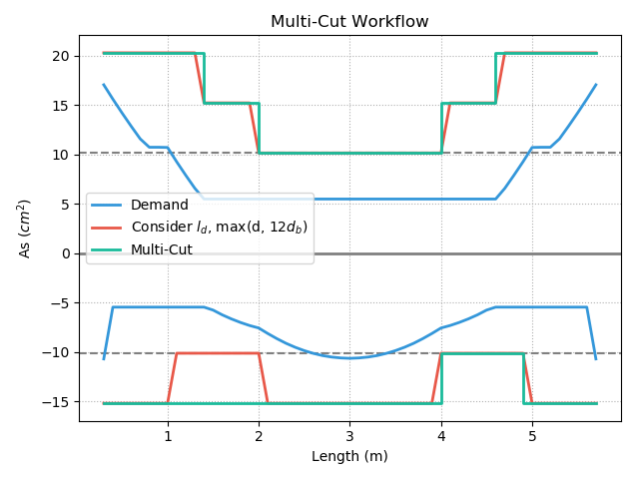
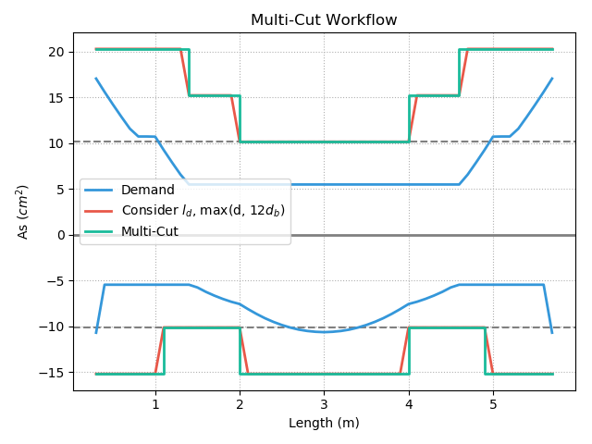
Multi-Cut
Top
Multi-Cut-4
Multi-Cut-2
Bottom
Notes:
GA 演算法
LowSeismic 4Floor 12M 4
LowSeismic 4Floor 12M 0

Slide 12
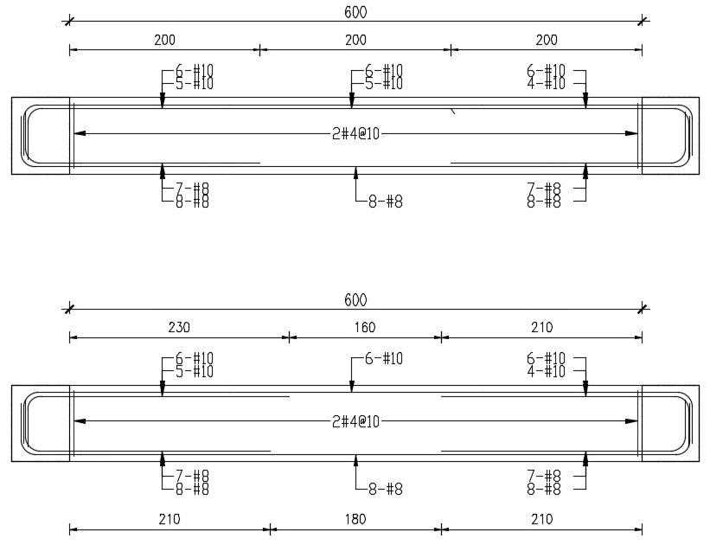
現行鋼筋配置示意圖
最佳化鋼筋配置示意圖
Notes:
同第三頁的圖
這個可以仔細想想

Slide 13


Slide 14
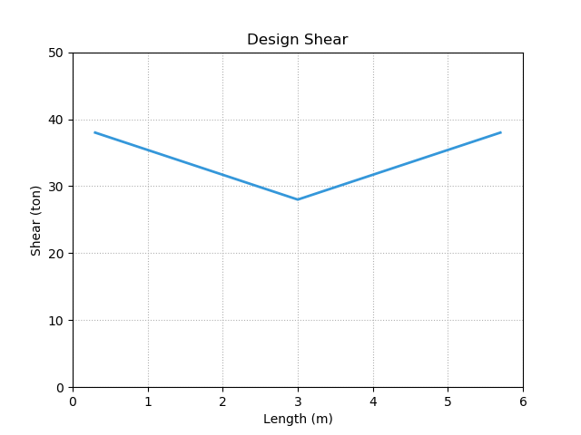
Design Shear - Vu
Notes:
LowSeismic4Floor12M 0

Slide 15
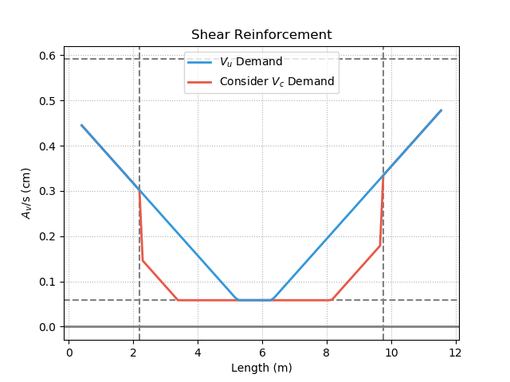
Shear Reinforcement
5.11.5
Notes:
LowSeismic4Floor12M 0

Slide 16
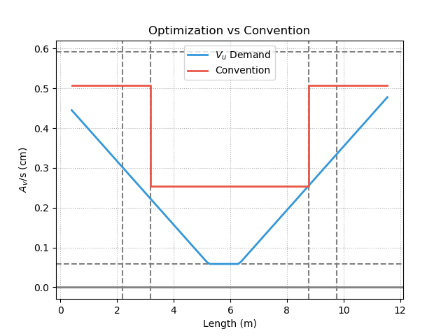
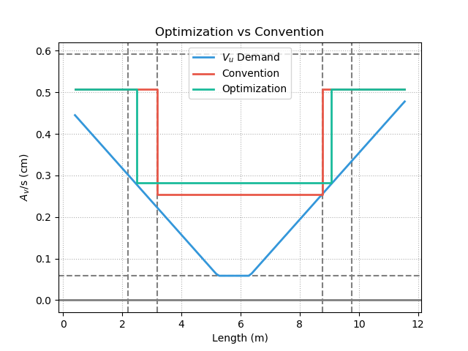
Shear Reinforcement
Notes:
LowSeismic4Floor12M 0

Slide 17
Outline
Part 2
Part 4
Methodology
Seismic Verification
Part 1
Part 3
Objective
Condition
- Flexural

Slide 18
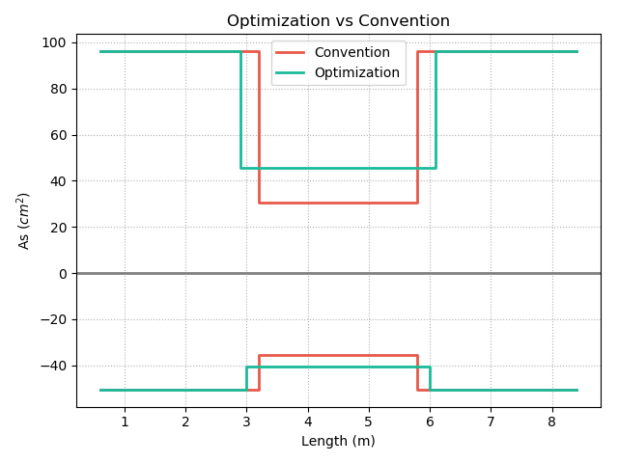
Optimization vs Convention
12-#10
19-#8
19-#8
10-#10
3-#10
78%
6-#8
102%
94%
103%
7-#8
9-#8
7-#8
12-#8
10-#8
10-#8
Notes:
同第3頁

Slide 19
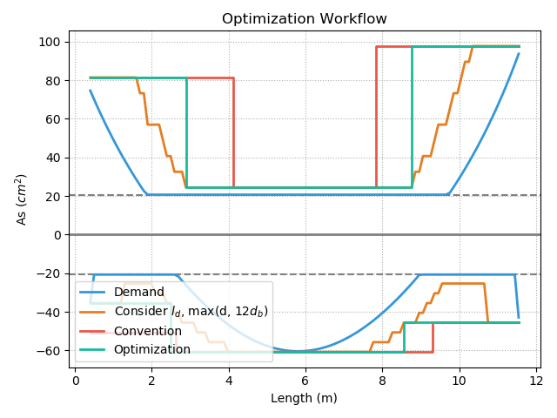
Factors
Convention

Slide 20
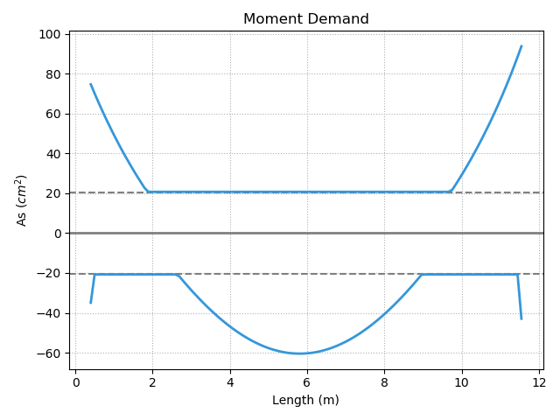
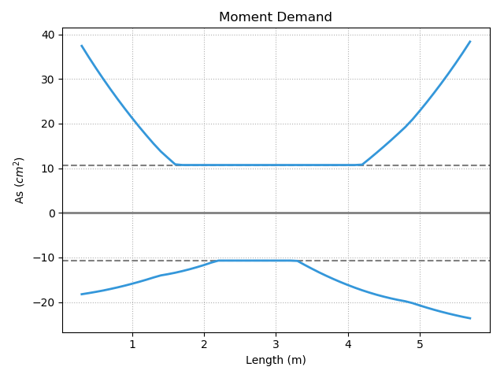
Moment Slope Large
Large Slope
Small Slope
Notes:
LowSeismic4Floor12M 0

Slide 21
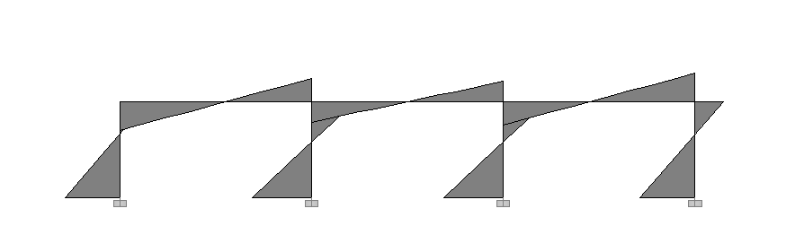
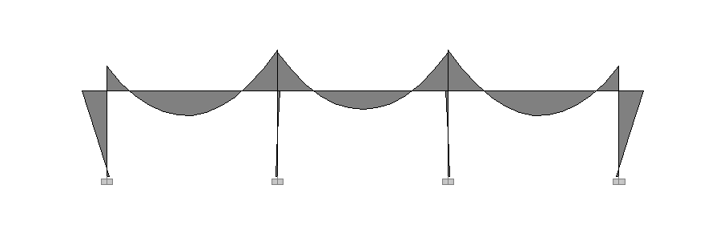
Lateral Load
Small Slope
Large Slope
Moment Diagram
Gravity Load

Slide 22
Moment Slope Large
Large Slope

Slide 23
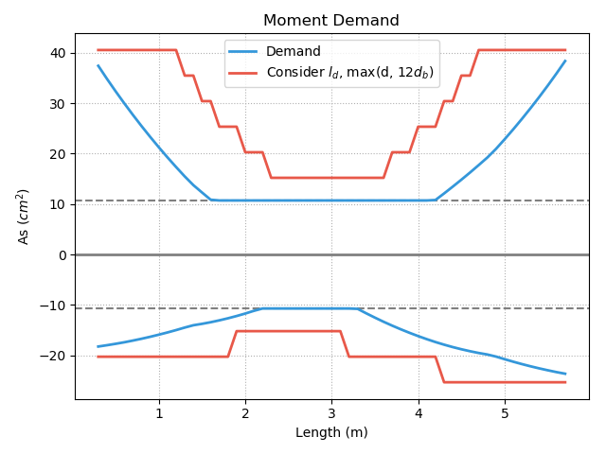
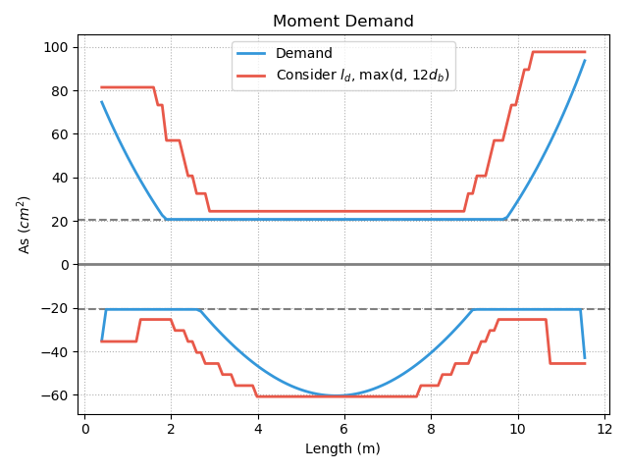
Short
Development Length
Notes:
LowSeismic4Floor12M 0

Slide 24
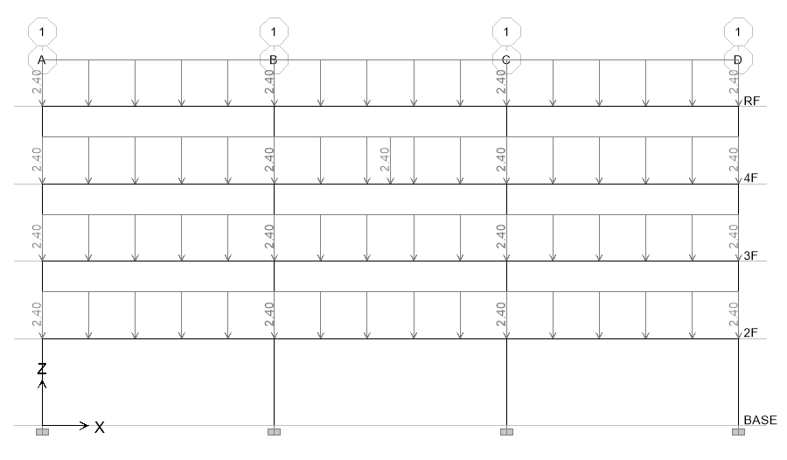
20 Models
4m
4.5m
Notes:
LowSeismic4Floor12M 0

Slide 25
Top Reinforcement

Slide 26
Bottom Reinforcement

Slide 27
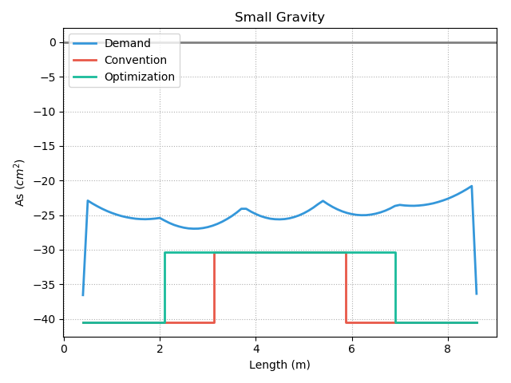
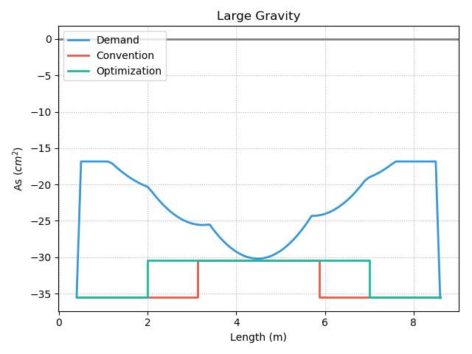
Middle Less Than End
7%
6-#8
7%
8-#8
8-#8
7-#8
4%
6-#8
4%
7-#8

Slide 28
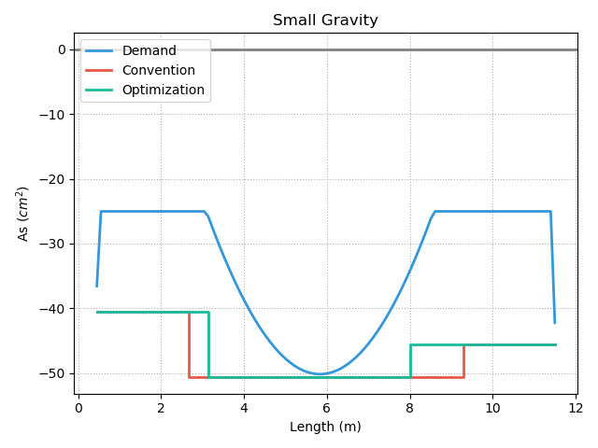
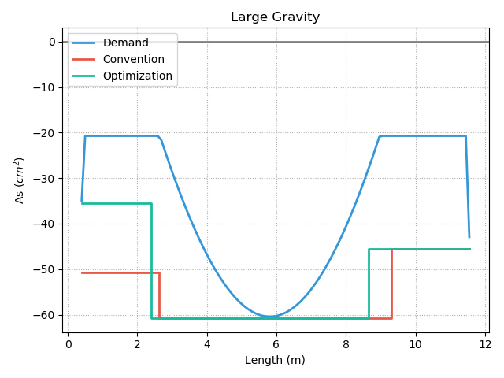
Middle More Than End
7-#8
6%
8-#8
10-#8
9-#8
12-#8
9-#8
2%

Slide 29
Total Reinforcement

Slide 30
#8 => #10 Reinforcement

Slide 31
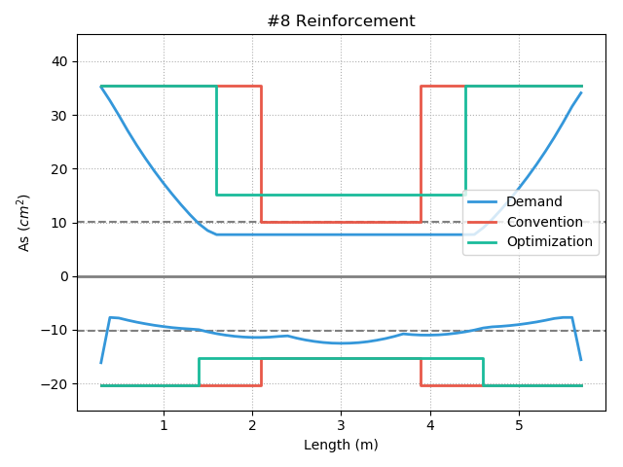
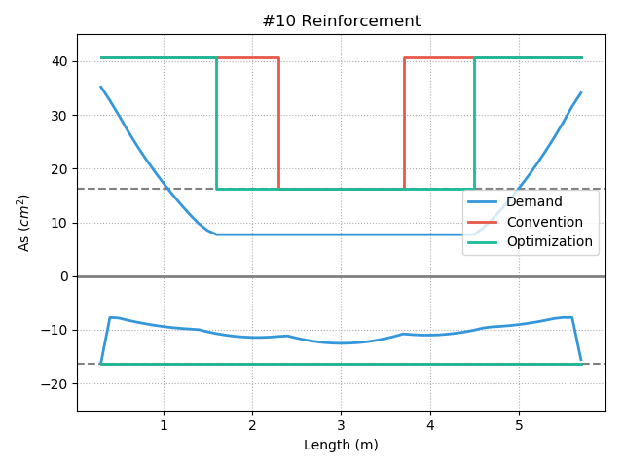
Convention Increase
13%
13%
7%

Slide 32
Different Stories Reinforcement

Slide 33
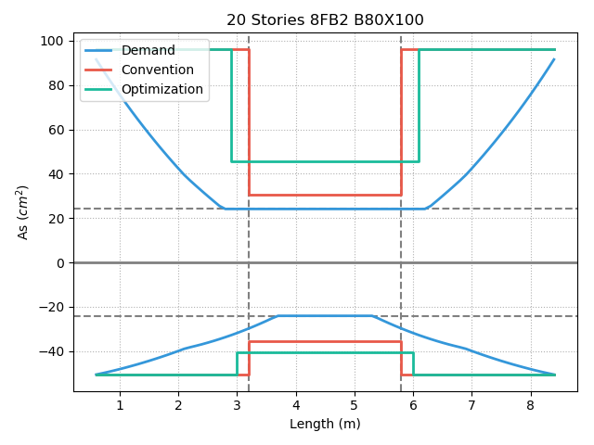
Convention Does Not
Meet Specifications
102%
103%

Slide 34
More Multi-Cut
Notes:
理論最佳解

Slide 35
Shear Reinforcement

Slide 36
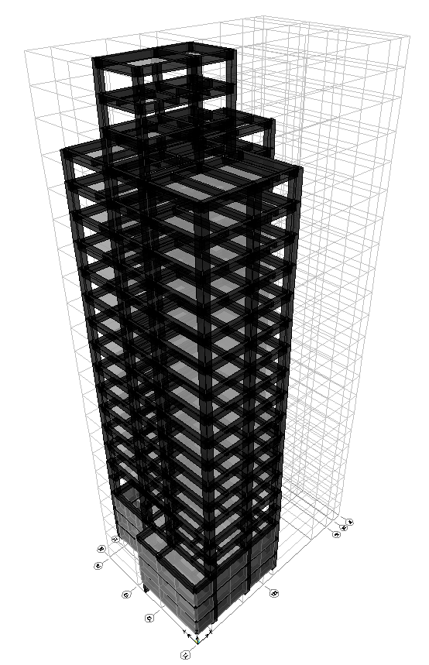
台北住宅案
14F B3
99.6%
High Seismic
Beam Length = 5, 6m
20m
30m
Notes:
由於很複雜，先記得最終的結果
400

Slide 37
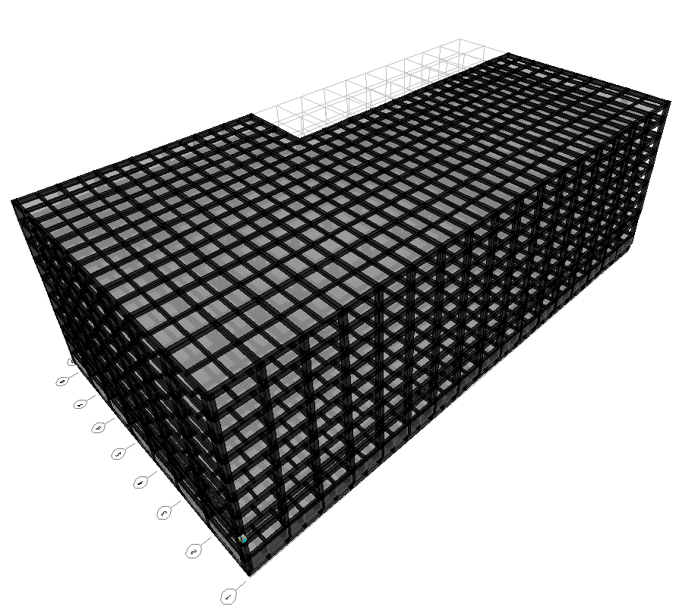
9F B1
94.3%
153m
Low Seismic
77m
Beam Length = 8, 10m
高雄物流中心
Notes:
3500

Slide 38
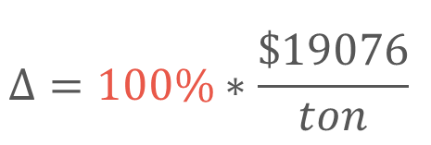
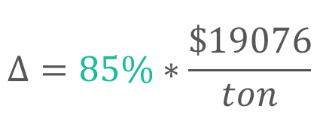
Material Cost
Convention
Optimization
$$Δ=100\%∗\frac{\$19076}{ton}$$
$$Δ=85\%∗\frac{\$19076}{ton}$$
Material Cost
Reduced Percentage (Multi-Cut-4)
資料來源: 公共工程價格資料庫 2019

Slide 39
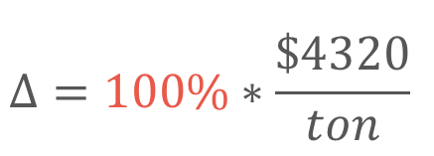
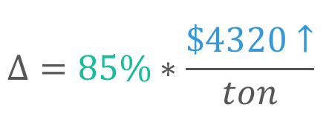
Construction Cost
Convention
Optimization
$$Δ=100\%∗\frac{\$4320}{ton}$$
$$Δ=85\%∗\frac{\$4320↑}{ton}$$
鋼筋綁紮工資
複雜度增加 => 鋼筋綁紮工資增加
資料來源: 公共工程價格資料庫 2019

Slide 40

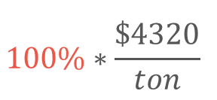

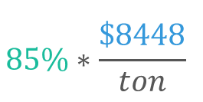
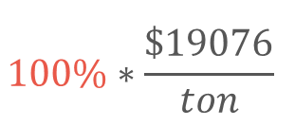
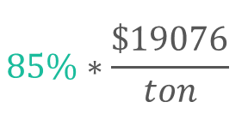
Cost Analysis
Convention
Optimization-Cut-4
$$100\%∗\frac{\$19076}{ton}$$
$$85\%∗\frac{\$19076}{ton}$$
Material Cost
Construction Cost
$$100\%∗\frac{\$4320}{ton}$$
$$85\%∗\frac{\$8448}{ton}$$
Total Cost
$$100\%$$
$$100\%$$

Slide 41

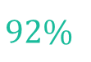
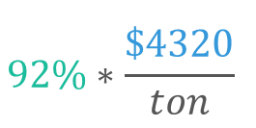
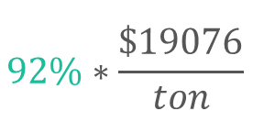
Cost Analysis
Convention
Optimization-Cut-2
$$100\%∗\frac{\$19076}{ton}$$
$$92\%∗\frac{\$19076}{ton}$$
Material Cost
Construction Cost
$$100\%∗\frac{\$4320}{ton}$$
$$92\%∗\frac{\$4320}{ton}$$
Total Cost
$$100\%$$
$$92\%$$

Slide 42
Outline
Part 2
Part 4
Methodology
Seismic Verification
Part 1
Part 3
Objective
Condition

Slide 43
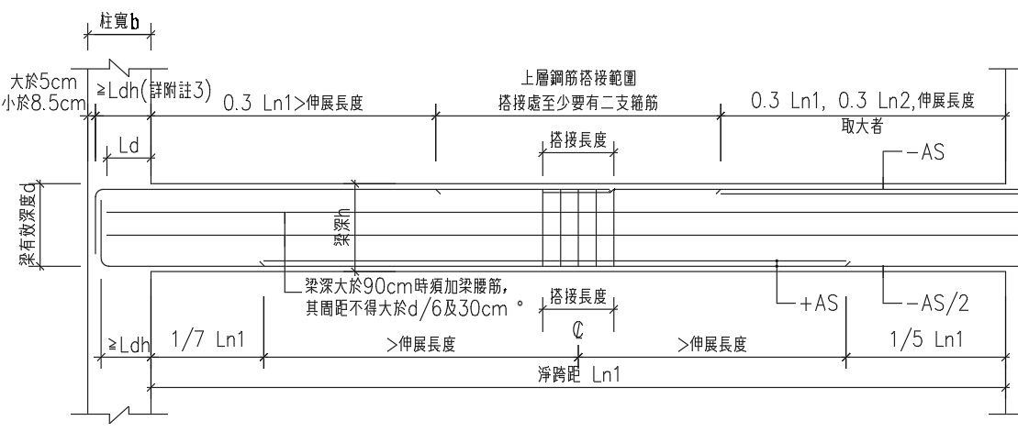
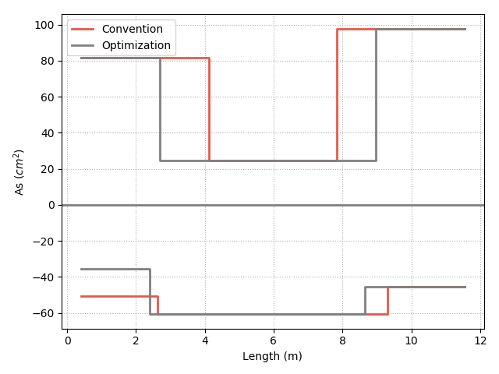
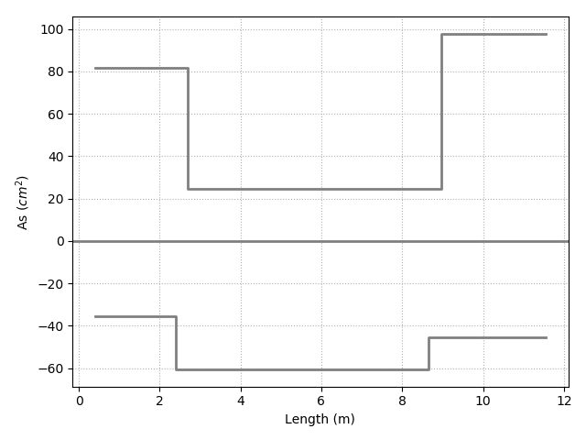
12-#10
Consider Ld
12-#10
10-#10
10-#10
3-#10
3-#10
7-#8
7-#8
9-#8
9-#8
12-#8
12-#8

Slide 44
Pushover Methods
Capacity Spectrum Method
Modal Pushover Analysis
Multi-Modes Combination
Mode Shape
Effective Mass
(ATC-40, 1996)
(Chopra & Goel, 2001)
(Kunnath, 2004)

Slide 45
Capacity Spectrum Method
Notes:
Low Seismic 12m 90.4%

Slide 46
Modal Pushover Analysis – Mode1

Slide 47
Modal Pushover Analysis – Mode2

Slide 48
Multi-Modes Combination

Slide 49




Step 2
Step 3
Step 5
Step 6

Slide 50

Gravity Load
Forth Hinge
Gravity Load
+
Lateral Load

Slide 51

Time History Analysis
Scaled to DBE, MCE
Story Drift
DBE < 1.5%
MCE < 2%

Slide 52


DBE < 1.5%

Slide 53


MCE < 2.0%

Slide 54




Convention DBE
Optimization DBE
Convention MCE
Optimization MCE
Notes:
DBE 1602 11.5
MCE 1116 15.5

Slide 55



Incremental Dynamic Analysis
(Vamvatsikos & Cornell, 2002)
4% FEMA273

Slide 56


Incremental Dynamic Analysis

Slide 57

Elastic
Match
Non-Negative
Equal displacement
Negative
Softening
(Vamvatsikos & Cornell, 2002)

Slide 58

Pushover IDA Difference

Slide 59
Capacity Spectrum Method

Slide 60

Capacity Spectrum Method

Slide 61

IM
Base Shear

Slide 62
Nonlinear Analysis
 | ATC-40 |  |  |  | Modal Pushover Analysis |  |  |  | Multi-Modes Combination
 | Convention |  | Optimization |  | Convention |  | Optimization |  | Convention |  | Optimization
 | R_{a} | R | R_{a} | R | R_{a} | R | R_{a} | R | R_{a} | R | R_{a} | R
High Seismic, 4 | 2.73 | 3.42 | 2.81 | 3.53 | 2.74 | 3.43 | 2.82 | 3.54 | 2.71 | - | 2.92 | -
Mid Seismic, 4 | 1.35 | 1.52 | 1.34 | 1.51 | 1.41 | 1.59 | 1.4 | 1.58 | - | - | - | -
Low Seismic, 4 | 1.24 | 1.66 | 1.25 | 1.66 | 1.28 | 1.7 | 1.27 | 1.71 | 1.40 | 1.78 | 1.38 | 1.76
Mid Seismic, 12 | 1.92 | 2.28 | 2.08 | 2.44 | 2.20 | 2.58 | 2.32 | 2.72 | - | - | 2.13 | 2.49
Mid Seismic, 20 | 1.44 | 1.63 | 1.50 | 1.71 | 1.88 | 2.11 | 1.87 | 2.10 | 2.00 | 2.33 | 2.03 | 2.37
Story Drift | DBE |  |  |  | MCE
 | Convention |  | Optimization |  | Convention |  | Optimization
 | Median | Mean | Median | Mean | Median | Mean | Median | Mean
High Seismic, 4 | 0.98% | 1.04% | 0.98% | 1.04% | 1.28% | 1.35% | 1.28% | 1.35%
Mid Seismic, 4 | 1.22% | 1.17% | 1.22% | 1.17% | 1.26% | 1.27% | 1.27% | 1.27%
Low Seismic, 4 | 0.72% | 0.71% | 0.72% | 0.71% | 0.89% | 0.91% | 0.89% | 0.91%
Mid Seismic, 12 | 0.92% | 0.89% | 0.92% | 0.89% | 1.02% | 0.98% | 1.02% | 0.98%
Mid Seismic, 20 | 1.21% | 1.16% | 1.21% | 1.16% | 1.40% | 1.32% | 1.40% | 1.32%
MPA | R_{a} | R
High Seismic, 4 | 1.03 | 1.03
Mid Seismic, 4 | 0.99 | 0.99
Low Seismic, 4 | 0.99 | 1.01
Mid Seismic, 12 | 1.05 | 1.05
Mid Seismic, 20 | 0.99 | 1.00
Story Drift, Median | DBE | MCE
High Seismic, 4 | 1.00 | 1.00
Mid Seismic, 4 | 1.00 | 1.01
Low Seismic, 4 | 1.00 | 1.00
Mid Seismic, 12 | 1.00 | 1.00
Mid Seismic, 20 | 1.00 | 1.00
S_{a} (T₁, 5%) | Convention |  |  | Optimization
 | 16% | 50% | 84% | 16% | 50% | 84%
High Seismic, 4 | 3.00 | 2.65 | 1.99 | 3.00 | 2.70 | 2.03
Mid Seismic, 4 | 1.80 | 1.00 | 0.80 | 1.80 | 1.10 | 0.80
Low Seismic, 4 | 1.30 | 1.10 | 0.70 | 1.30 | 1.10 | 0.75
Mid Seismic, 12 | 1.44 | 0.92 | 0.50 | 1.50 | 0.94 | 0.50
Mid Seismic, 20 | 1.33 | 0.81 | 0.51 | 1.28 | 0.81 | 0.57
S_{a} (T₁, 5%) | 50%
High Seismic, 4 | 1.02
Mid Seismic, 4 | 1.10
Low Seismic, 4 | 1.00
Mid Seismic, 12 | 1.02
Mid Seismic, 20 | 1.00

Slide 63
Conclusion
Methodology
Condition
Capacity
- Flexural
- Shear
- Low Seismic
- Long Span
- Short L_{d}
- Small d
Close to Convention
Objective
Effect
Cost
Reduce Rebar
- Flexural 8%
- Shear 3%
Today or Future Cost

Slide 64





Mu
Consider Hundreds Of Combo Demand
Critical Demand Combo
$$A_{s}({cm}^{2})$$
$$A_{s}({cm}^{2})$$
Length(m)
Length(m)

Slide 65


Design Moment - Mu
(1) U=1.4D
(2) U=1.2D + 1.6L
(3) U=1.2D + (1.0L or 0.5L)
(4) U=1.2D + 1.6W + (1.0L or 0.5L)
(5) U=1.2D + 1.0E + (1.0L or 0.5L)
(6) U=0.9D + 1.6W
(7) U=0.9D + 1.0E

Slide 66


Design Moment - Mu
(1) U=1.4D
(2) U=1.2D + 1.6L
(3) U=1.2D + (1.0L or 0.5L)
(4) U=1.2D + 1.6W + (1.0L or 0.5L)
(5) U=1.2D + 1.0E + (1.0L or 0.5L)
(6) U=0.9D + 1.6W
(7) U=0.9D + 1.0E

Slide 67




General Development Length Equation
Procedure A
MIN
Simplified Provisions

Slide 68
General Development Length Equation
Procedure A
MIN
Simplified Provisions

Slide 69

傳統梁鋼筋配置圖
最佳化梁鋼筋配置示意圖
Notes:
LowSeismic 4Floor 12M 0

Slide 70

Non-Linear SPO
Elastic
➔
Match
Non-Negative
➔
Equal Displacement
Negative
➔
Softening

